Slide 1
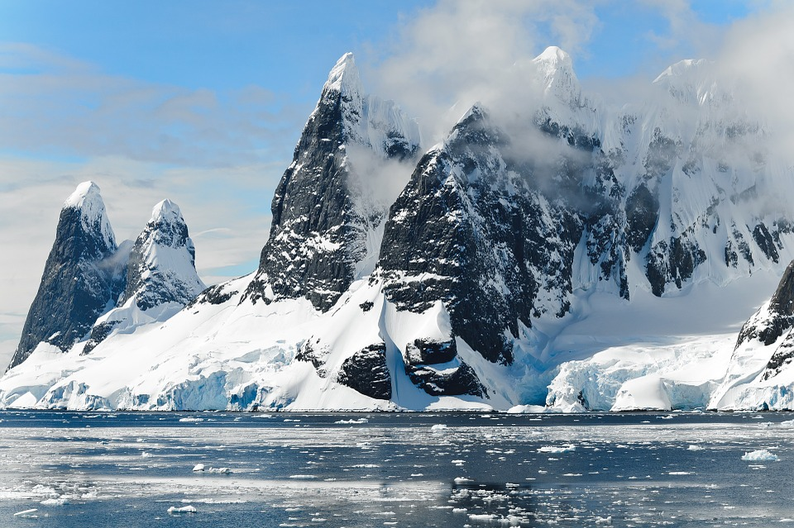
HAWK
Final
Report
CHENG, Di 20454037
CHEN, Ruiting 20568400
XUE, Yang 20565862
YE, Yifan 20551471
ZHANG, Mengkai 20563711
WELCOME

Slide 2

CONTENT
Collect materials from different information carriers and sources about Sensetime and one of its major competitors – Megvii
Perform natural language processing on materials collected
Through statistics of high frequency words, auto-generated topics and sentiment analysis and comparing these results with Megvii’s (analysis about Sensetime’s patent and researchers’ background is made manually)
Outline and summarize our project report and make three suggestions for further study
REPORT
REPORT
01
Information Collection
02
Information Analysis
03
Synthesis and suggestion for further study

Slide 3

01
Information Collection
Web Crawler
Facial Recognition
Voice Recognition
GET STARTED

Slide 4
Web Crawler
Web crawler is a program that acts as an automated script which browses through the internet in a systematic way. The web crawler looks at the keywords in the pages, the kind of content each page has and the links, before returning the information to the search engine.
In our project, since there is massive news related to our target company, it is much more efficient to use the web crawling technology to collect useful information. Then, we use XML Path Language (XPath) to conduct the web crawling.

Slide 5
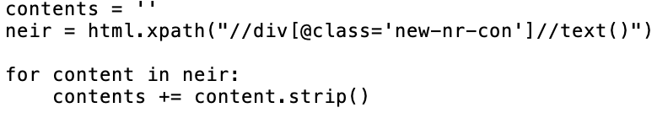
Web Crawler
We conduct the web crawling in the following steps: (set extracting SENSETIME’s news as an example)
Obtain the information of target website
We choose to collect the news published on the official website of SENSETIME, then we set the url as https://www.sensetime.gcom/news/view/id/21.html.
Collect the information of target website
We need to extract the Title, Date and Context of the news:
locate the Title and Date labels as follows:
Our corresponding codes are:
locate the label of Content:
To obtain the content, our corresponding codes are:

Slide 6
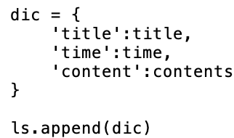
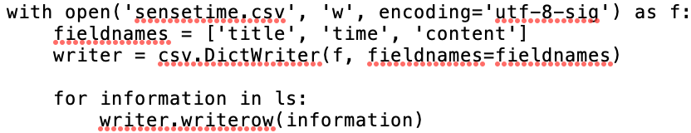
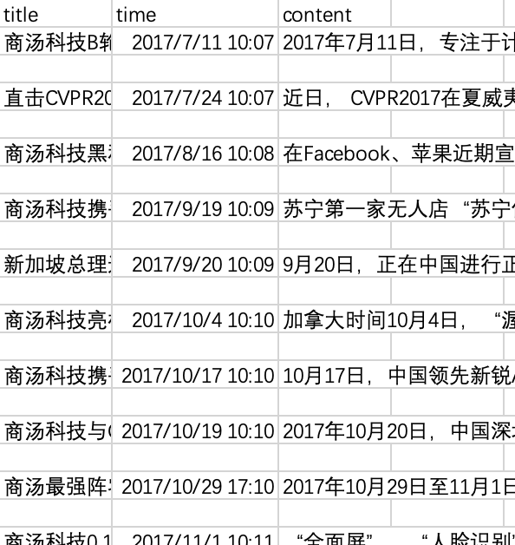
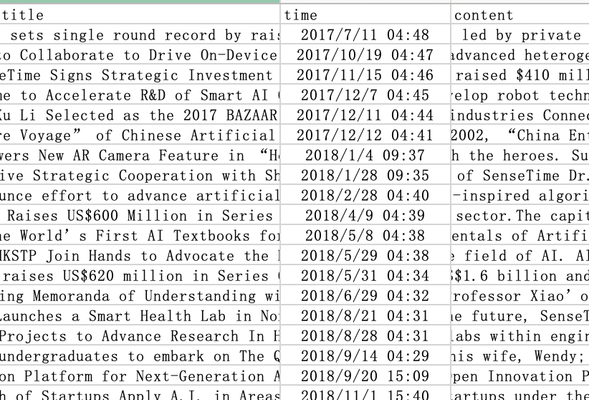
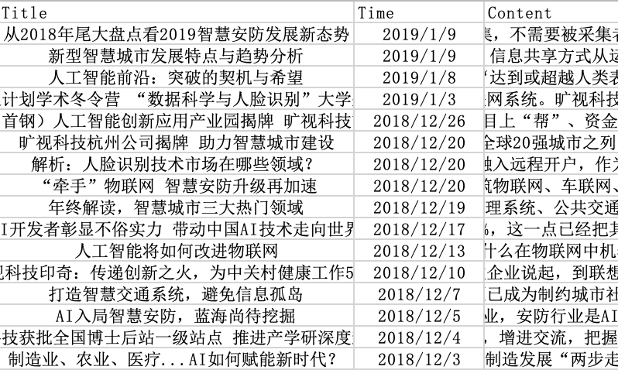
Web Crawler
We conduct the web crawling in the following steps: (set extracting SENSETIME’s news as an example)
Save and export the data:
After we extract the three parts of each news, we save them as an excel file for further researching:
Our final results in excel format showed as below:

Slide 7
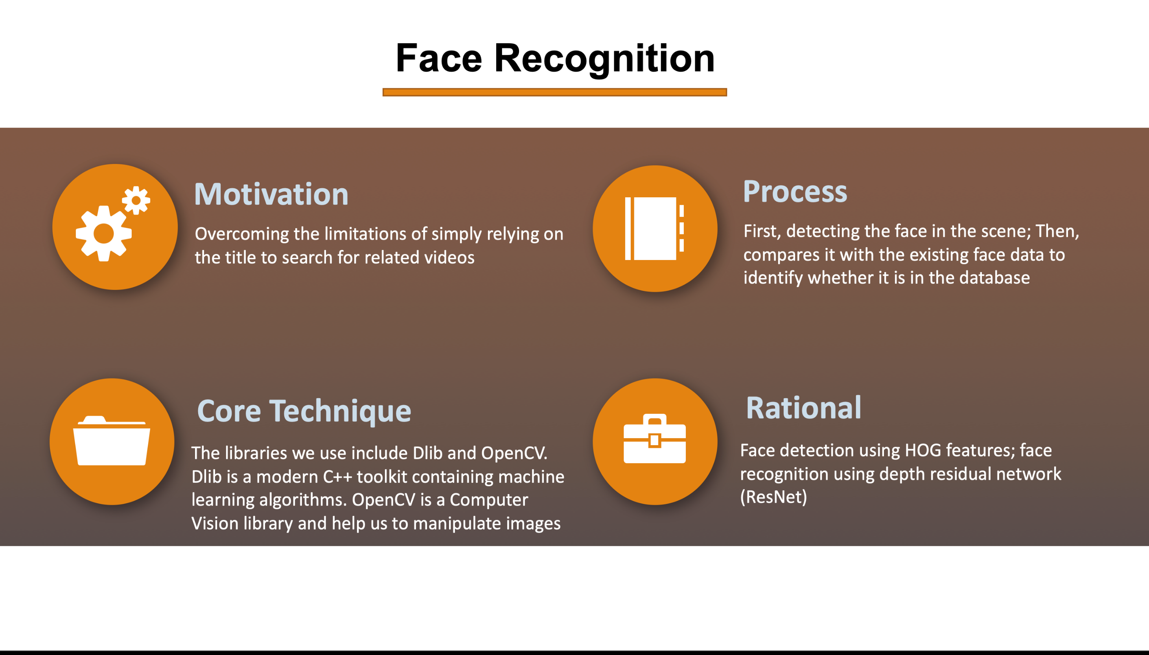

Slide 8
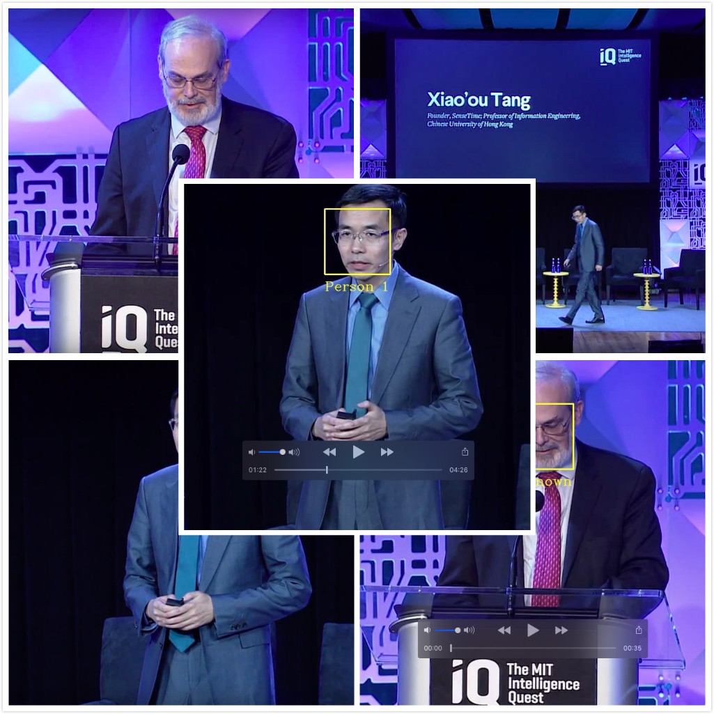
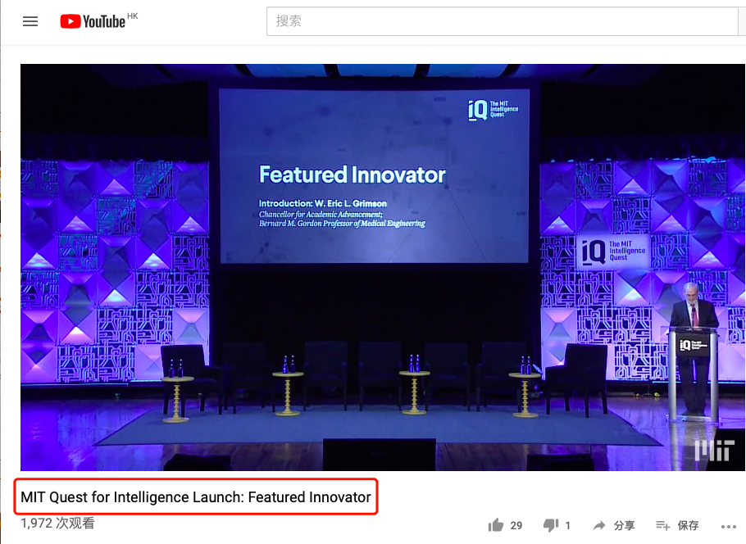
Face Recognition
MIT Quest for Intelligence Launch: Featured Innovator

Slide 9
Framework of Face Recognition
Detect face
Save face features-
128D eigenvectors:
Build up datatbase
Calculate the distance between the eigenvectors
Compare with threshold
Get result
Get face landmarks 68 points
Get new face feature
From video
Face Recognition
Face Recognition

Slide 10
Voice Recognition
facial recognition/
scalable web crawler
Convert online video to audio
Noise removal
Solve problems in programing
Speech recognition
Determine the speech recognition module
Voice-to-text
Voice-to-text

Slide 11
Voice Recognition
Determine the speech recognition module
Convert online video to audio
Noise removal
Solve problems in coding
Baidu
Baidu user
IBM
IBM user /SpeechRecognition)
→ Accuracy 、convenience
Google
SpeechRecognition
Method 1:Save the recording with the Microphone through the pyaudio module
Method 2:After downloading the video, extract the audio through the ffmpeg package to get the audio in wav format
network interruption → 30s per segment & looping statements
Time out → 5s waiting time between cycles
r.adjust_for_ambient_noise()
TEXTHER

Slide 12
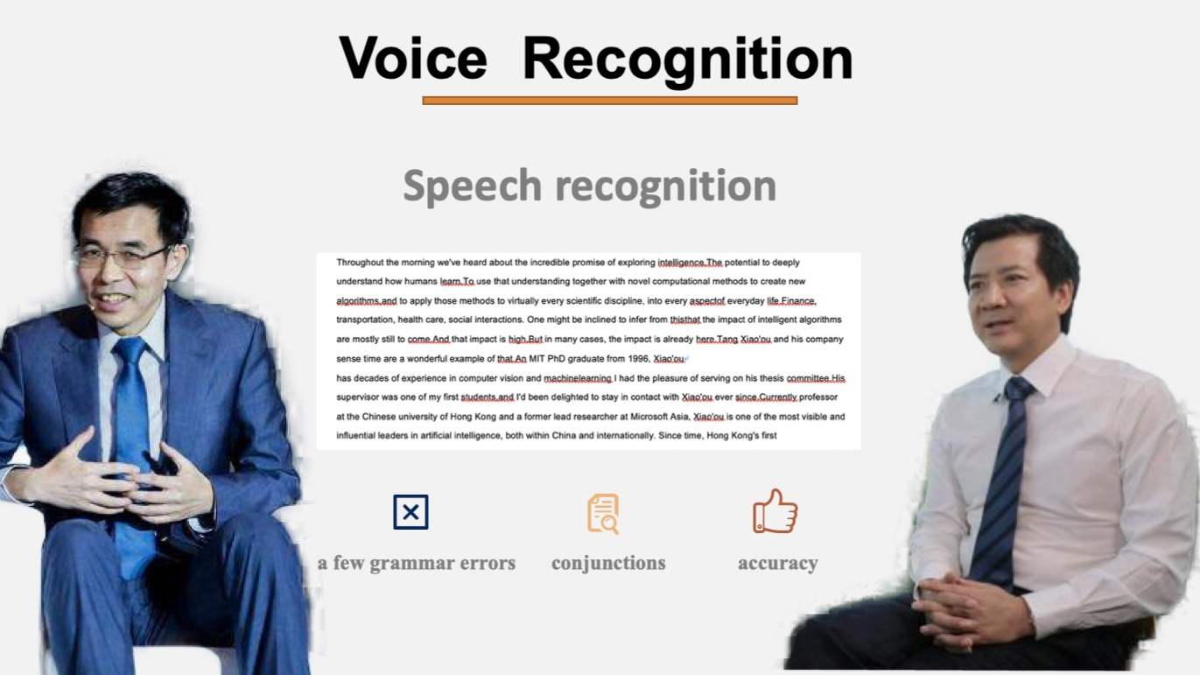
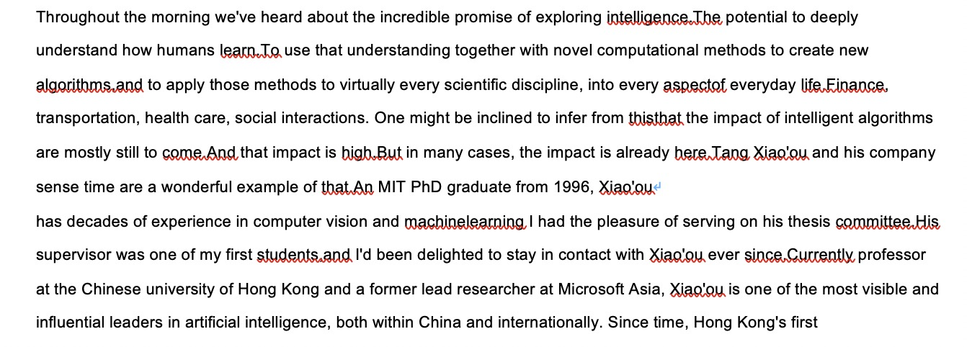
Voice Recognition
Speech recognition
a few grammar errors
conjunctions
accuracy

Slide 13
02
Information Analysis
High-frequency words & topic model sentence
Sentiment Analysis
Word cloud
Patent
Researchers’ Background

Slide 14


WordCloud (All-time / English)

Slide 15
WordCloud (All-time / Chinese)

Slide 16
Word Frequency (Two-Monthly)
May, 2018 and before | China / MIT / Industry
June & July, 2018 | Singapore / NSCC / Singtel (telecommunications company)
Aug & Sept, 2018 | MIT / Project / Science / Quest / Student
Oct & Nov, 2018 | Hong Kong / HKAI Lab / Startup
Dec, 2018 & Jan, 2019 | Autonomous Driving / Singapore / NTU / User / 3D / Smartphone
Feb & Mar, 2019 | Education / Qualcomm (semiconductor and telecommunications equipment company) / CUHK
Apr & May, 2019 | Malysia / G3 Global / Visteon (automotive electronics supplier) / Bureau
May, 2018 and before | Retail / Fresh Life / Convenience Store
June & July, 2018 | Unicorn / Fu Yingbo / Structured Light / hangzhou
Aug & Sept, 2018 | Face Recognition / 3D / Zhongguancun / Bank Beijing / Algorithm
Oct & Nov, 2018 | Security / Data / Mobile Phone / Bounding Box / Detection / Innovation
Dec, 2018 & Jan, 2019 | Smart City / Information / System / Transportation / Urban
Feb & Mar, 2019 | Scene / Core / IoT (Internet of things) / Enterprise / Innovative / Enthusiasm
Apr & May, 2019 | Image / Categories / Objects 365 (a data set) / Financing / Ant Financial / Security

Slide 17
Auto-generated Topic (Two-Monthly)
May, 2018 and before | complete image monitor raw
June & July, 2018 | complementary city establish opportunity
Aug & Sept, 2018 | experience entity nuclear incorporate / cognitive new executive science
Oct & Nov, 2018 | commit machine mobility equip
Dec, 2018 & Jan, 2019 | sensetime ai technology autonomous / also mobile beautification algorithm
Feb & Mar, 2019 | AI sensetime education school
Apr & May, 2019 | closely real accompany cockpit / ai educaiton sensetime shanghai
May, 2018 and before | important solve display capability
June & July, 2018 | hardware rapid step afternoon / three equipment password android
Aug & Sept, 2018 | expensive constantly peking computer / technology AI recognition
Oct & Nov, 2018 | RNN foreground mathematical early / coefficient mainland role workshop
Dec, 2018 & Jan, 2019 | intelligence artificial technology city / senior dog quantityt segmentation
Feb & Mar, 2019 | super essential city ecosystem / conform 000 chain robot
Apr & May, 2019 | index objects365 food mark / fund expand main competitor

Slide 18
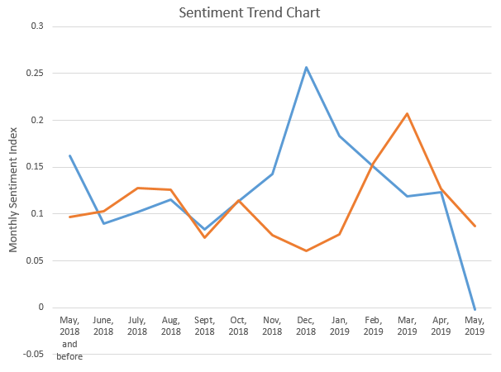
Sentiment Analysis

Slide 19
Patent
AI Platform
943
Patents in traditional computer vision technologies such as face recognition, video processing, and algorithm model
Set up
PATENT
As of May 2019, SenseTime applied for 943 domestic patents and 67 foreign patent applications.
67
2014
2015
2016
2017
2018
2019
20120
2021
2022
2023

Slide 20

RESEARCH BACKGROUND
TANG Xiaoou, founder of SenseTime Technology，the “blazer” and “pathfinder” of global face recognition technology, began to focus on computer vision technology when he was pursuing his Ph.D. at the Massachusetts Institute of Technology in 1992
CORE TEAM
HARDWARE
Ph.D from the MIT, CUHK, Tsinghua University, Peking University, etc.
Deep learning super-calculation center with more than 10,000 GPUs.
CAPITAL
ACADEMIC
Many financing with valuation of 6 billion US dollars
Prompt research-type scholars into the industry

Slide 21

03 Synthesis and suggestion for further study
Synthesis:
Sensetime is developing smoothly and worth of investment. Although it is not as promising as before according to the result of sentiment analysis, we are still optimistic about Sensetime’s future.
Three Suggestions:
Further learning of programming languages, especially Python is essential.
Deeper understanding of AI technology is needed.
Some creative sources of information deserve more attention and analysis.

Slide 22
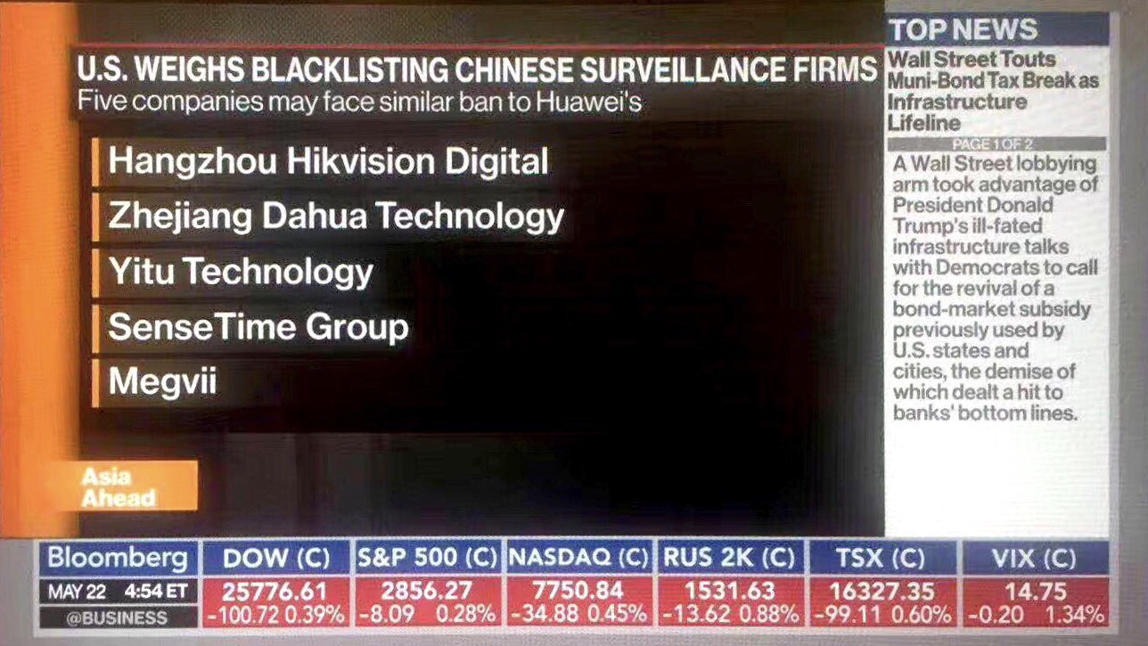
LATEST BREAKING NEWS

Slide 23
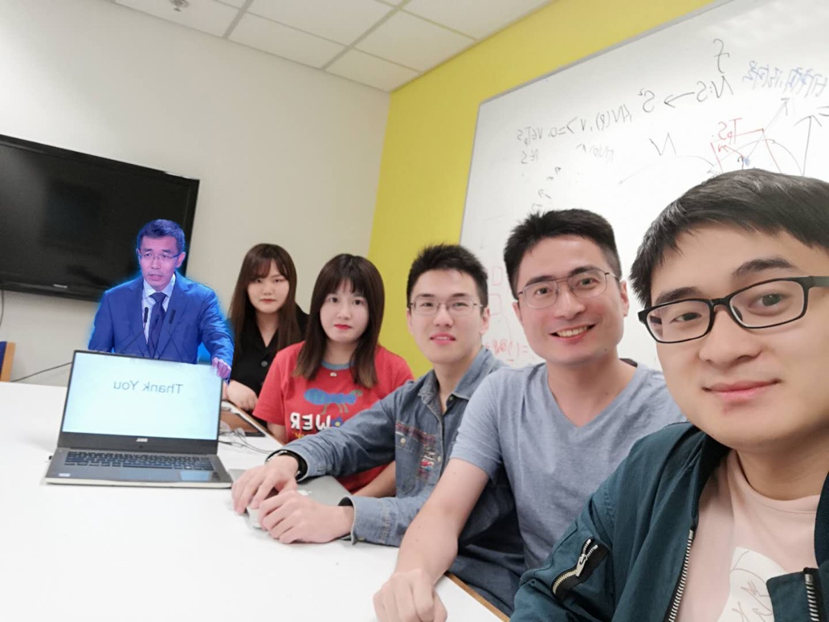
Thank You
Thank You
24th, MAY 2019
https://github.com/gigondor/HKUST-MAFS-6010U-HAWK

